Slide 1
INDEXING WIKI DUMPS On CLOUD Using ELK Stack & SOLR

Slide 2
PROJECT DESCRIPTION
Loading Wiki Datasets and Indexing them on following Cloud Platforms using Elasticsearch and Kibana
Amazon Web Services
Google Cloud Platform
Microsoft Azure

Slide 3
WHAT IS INDEXING
Indexing is a way to optimize performance of a database by minimizing the number of disk accesses required when a query is processed.
An index or database index is a data structure which is used to quickly locate and access the data in a database table.

Slide 4
INDEXING WIKI DUMPS On GOOGLE CLOUD PLATFORM using ELK Stack

Slide 5
ELASTICSEARCH
Elasticsearch is an open source engine based on Lucene .
It is Java-based and designed to operate in real time. It can search and index document files in diverse formats.
Elasticsearch is able to execute complex queries extremely fast.
Capable of scaling to hundreds of servers and petabytes of structured and unstructured data

Slide 6
LOGSTASH
• Logstash is a tool for managing events and logs.
• The purpose of Logstash is to get events from any number of inputs (could be from a file, a queue, another Logstash instance, etc), apply filters (parse, modify, or perform any number of processing tasks), and finally output to any number of destinations.

Slide 7
KIBANA
Kibana is an open source analytics and visualization platform designed to work with Elasticsearch.
You use Kibana to search, view, and interact with data stored in Elasticsearch indices.
Easily perform advanced data analysis and visualize your data in a variety of charts, tables, and maps.
Kibana makes it easy to understand large volumes of data.
Quickly create and share dynamic dashboards that display changes to Elasticsearch queries in real time.

Slide 8
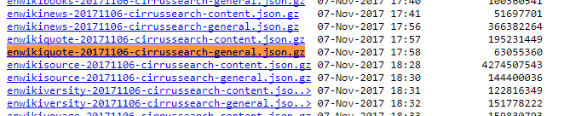
DATASET
The dataset chosen is wikiquote data available online which can be downloaded at https://dumps.wikimedia.org/other/cirrussearch/20171106/enwikiquote-20171106-cirrussearch-general.json.gz

Slide 9
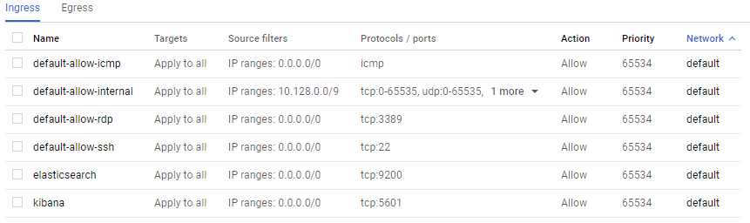
CREATING FIREWALL in GCP
Firewalls for Elasticsearch and Kibana are added with the IP range set to 0.0.0.0/0 and TCP protocols set to 9200 for Elasticsearch and 5601 for Kibana.

Slide 10
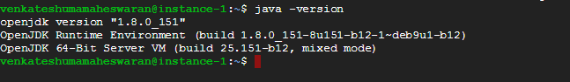
INSTALLING JAVA ON GCP
$ sudo apt-get install default-jre
Installs java and ensures we are using an up to date version. ELK stack requires version 1.8+

Slide 11
INSTALLING ELASTICSEARCH ON GCP
$ wget -qO - https://packages.elastic.co/GPG-KEY-elasticsearch | sudo apt-key add -
This will fetch the latest ElasticSearch Version for us
$ echo "deb http://packages.elastic.co/elasticsearch/5.x/debian stable main" | sudo tee -a /etc/apt/sources.list.d/elasticsearch-5.x.list
$ sudo apt-get update
$ sudo apt-get install elasticsearch
$ sudo vi /etc/elasticsearch/elasticsearch.yml
Find the line referring to the network.host portion. It will be commented out. Uncomment the file and make it read network.host “0.0.0.0”

Slide 12
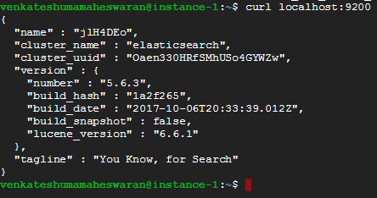
INSTALLING ELASTICSEARCH ON GCP
$ sudo service elasticsearch restart
Elasticsearch is installed and running on port 9200

Slide 13
INSTALLING LOGSTASH ON GCP
$ sudo apt-get install apt-transport-https
This setups installs for logstash in your system
$ echo "deb https://artifacts.elastic.co/packages/5.x/apt stable main" | sudo tee -a /etc/apt/sources.list.d/elastic-5.x.list
This will establish the source for Logstash
$ sudo apt-get update
$ sudo apt-get install logstash
$ sudo service logstash start
Start the logstash service so we can start shipping logs

Slide 14
INSTALLING KIBANA ON GCP
$ echo "deb http://packages.elastic.co/kibana/5.3/debian stable main" | sudo tee -a /etc/apt/sources.list.d/kibana-5.3.x.list
This will establish the source for Kibana
$ sudo apt-get update
$ sudo apt-get install kibana
$ sudo vi /etc/kibana/kibana.yml
Find the lines referring to server.port and ensure they say server.port: 5601 and server.host: “0.0.0.0”.

Slide 15
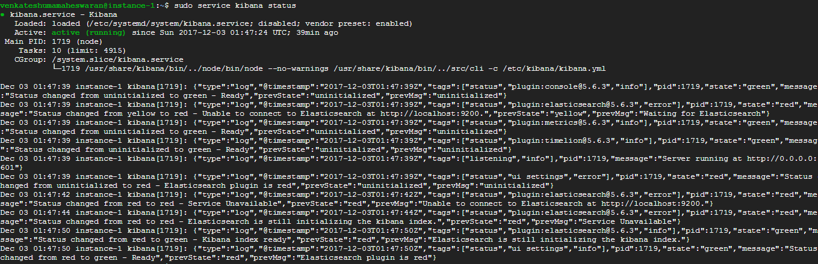
INSTALLING KIBANA ON GCP
$ sudo service kibana start

Slide 16
LOADING WIKI DATA AND INDEXING
Step 1: Download a wiki dump
Step 2: Get the index ready
Step 3: Prepare the wiki for loading
Step 4: Load the wiki

Slide 17
INDEXING WIKI QUOTE DATA
We need analysis-icu plugin for Elasticsearch to handle it the index.
bin/plugin install analysis-icu
Then we need jq for some of the json-foo we do next.
sudo apt-get install jq
Then we have to create 3 vim files createindex.sh, chunker.sh, uploader.sh

Slide 18
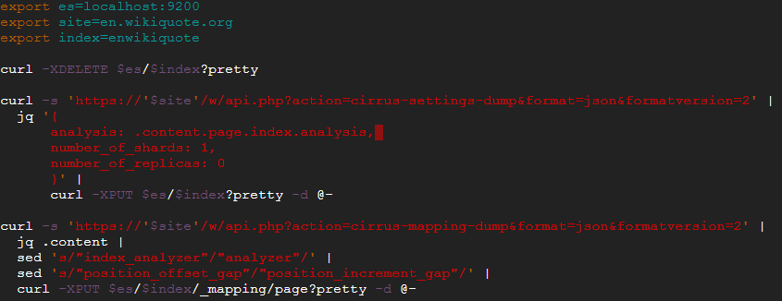
Createindex.sh

Slide 19
CODE EXPLANATION for Createindex.sh
export es=localhost:9200 sets up $es to be Elasticsearch's address.
export site=en.wikiquote.org sets up $site to be the hostname of the MediaWiki instance that you want to use.
export index=enwikiquote just sets $index to the name of the index you'll be loading.
curl -XDELETE $es/$index?pretty deletes the index if it already exists.

Slide 20
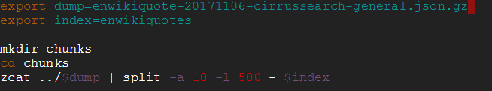
Chunker.sh
The first export line just names the file that you downloaded.
The mkdir and cd lines make a directory to hold the files.
The last line cuts the file into 500 line chunks. 250 of those lines are metadata lines for the _bulk api. 250 lines are the actual documents.

Slide 21
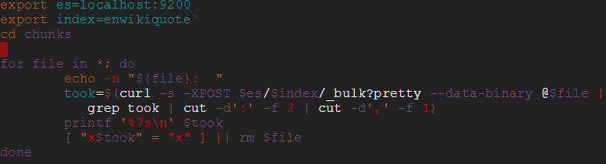
Uploader.sh
The first three lines should be familiar from above. The loop loads each file and deletes it after it's loaded.
If the file fails to load it isn't deleted and the loop moves on to the next file.

Slide 22
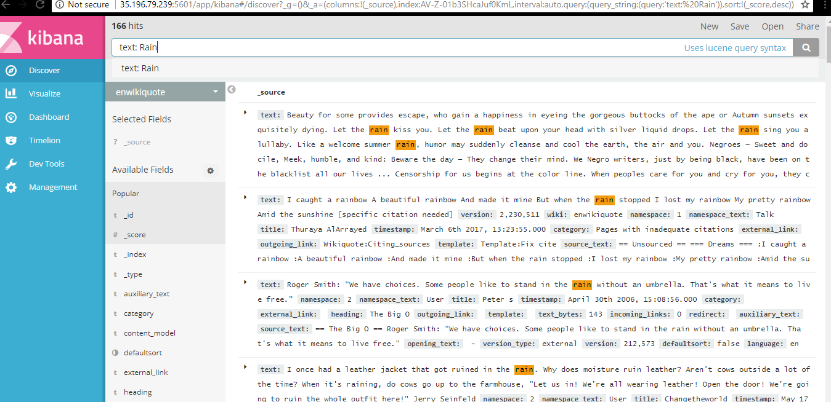
KIBANA VISUALIZATION

Slide 23
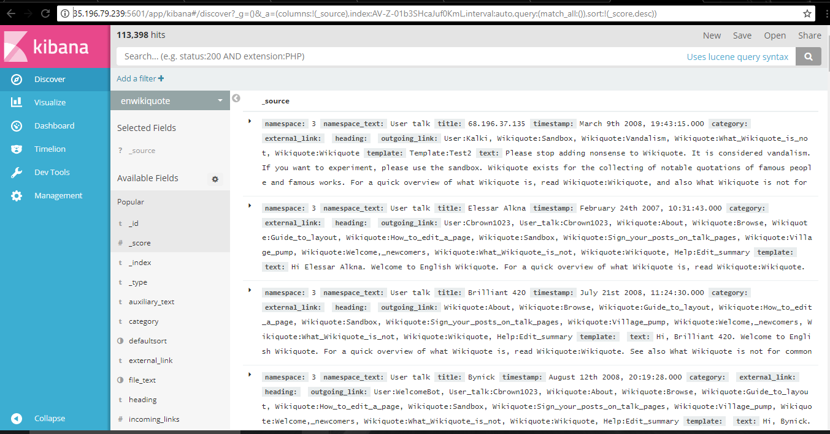
KIBANA VISUALIZATION

Slide 24
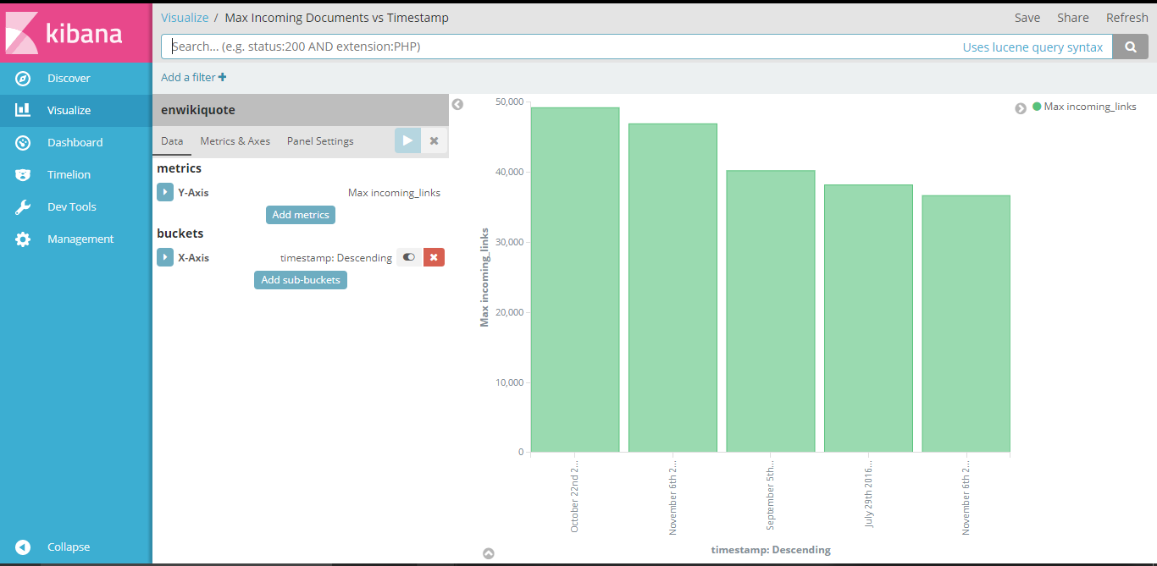
Visualizations

Slide 25
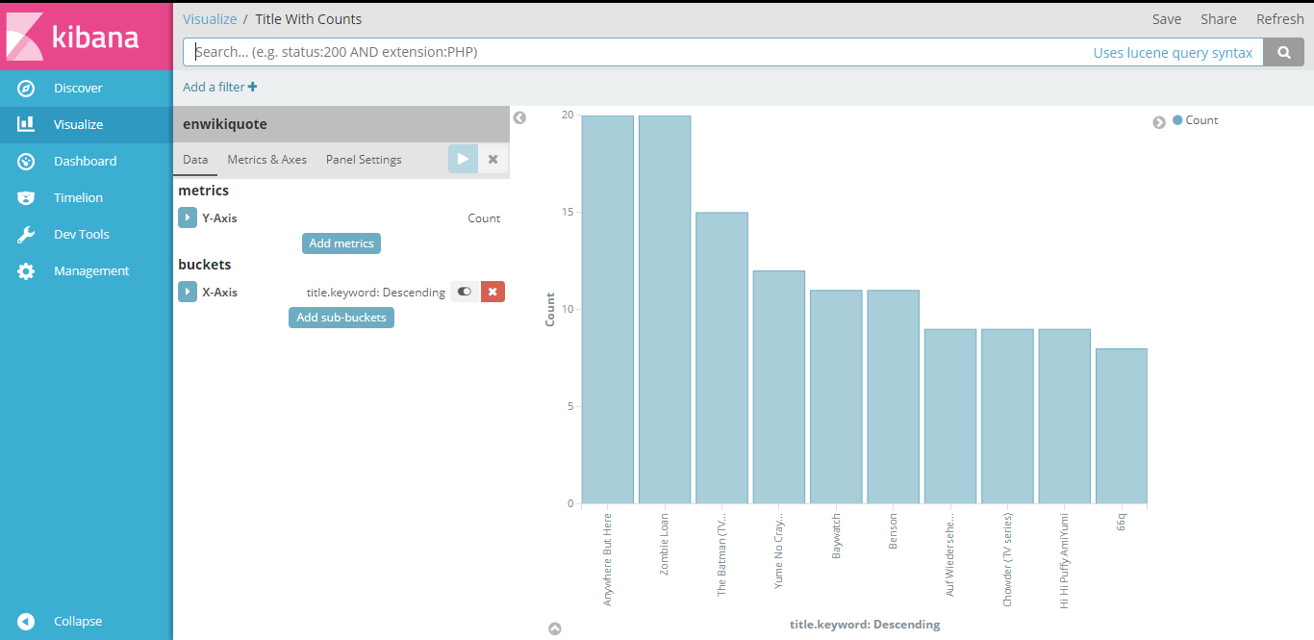
Visualizations

Slide 26
INDEXING WIKI DUMPS On AMAZON WEB SERVICES using ELK Stack

Slide 27
Amazon Web Services
The same commands are to be executed for installation of Elasticsearch, Logstash and Kibana as used for Google Cloud Platform.

Slide 28
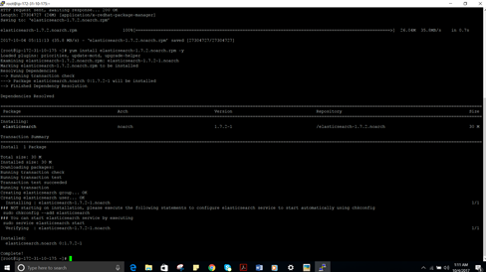
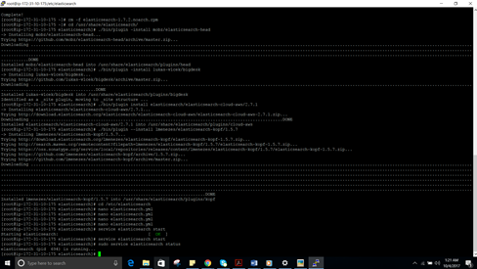
ELASTIC SEARCH INSTALLATION ON AWS

Slide 29
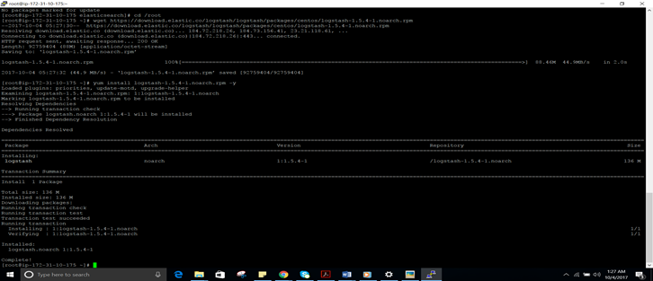
Logstash Installation on AWS

Slide 30
Kibana Installation and accessible through browser on AWS

Slide 31
Earthquakes Data
For more sample visualizations and better hands- on experience on Elasticsearch and Kibana, we tried this data available on github
https://github.com/elastic/examples/tree/master/Exploring%20Public%20Datasets/earthquakes

Slide 32
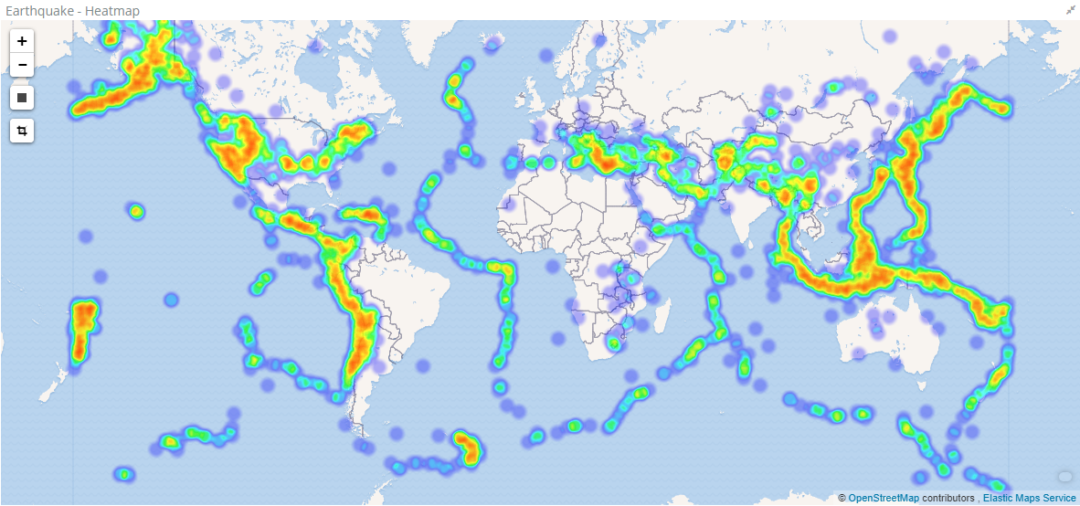
Visualizations

Slide 33
INDEXING WIKI DUMPS On MICROSOFT AZURE using SOLR

Slide 34
SOLR
Solr is powered by Lucene, a powerful open-source full-text search library, under the hood.
Solr is designed for scalability and fault tolerance.
Solr is widely used for enterprise search and analytics use cases.
XML/HTTP Interfaces
Loose Schema to define types and fields
Web Administration Interface
Extensive Caching
Index Replication
Extensible Open Architecture

Slide 35
Installation Steps of Solr
1. Download solr-3.4
2. Download wikipedia dump
3. data-config.xml was used to index Wikipedia dump.
<dataConfig>
<dataSource type="FileDataSource" encoding="UTF-8" />
<document>
<entity name="page"
processor="XPathEntityProcessor"
stream="true"
forEach="/mediawiki/page/"

Slide 36
Architecture
Admin
Interface
HTTP Request Servlet
Update Servlet
Standard
Request
Handler
Disjunction
Max
Request
Handler
Custom
Request
Handler
XML
Response
Writer
XML
Update
Interface
Solr Core
Schema
Caching
Update
Handler
Config
Analysis
Concurrency
Replication
Lucene

Slide 37
Indexing wikipedia
4. The relevant portion of schema.xml is below:
<field name="id" type="string" indexed="true" stored="true" required="true"/>
<field name="title" type="string" indexed="true" stored="false"/>
<field name="revision" type="sint" indexed="true" stored="true"/>
<field name="user" type="string" indexed="true" stored="true"/>
<field name="userId" type="int" indexed="true" stored="true"/>
<field name="text" type="text" indexed="true" stored="false"/>
<uniqueKey>id</uniqueKey>
<copyField source="title" dest="titleText"/>

Slide 38
Indexing wikipedia
5. Add Dih request handler in solrconfig.xml file
<requestHandler name="/update/dih" startup="lazy">
<lst name="defaults">
<str name="config">dih-config.xml</str>
</lst>
6. Restart solr
7. Index some documents using below command
http://localhost:8983/solr/update/dih?command=full-import

Slide 39
Schema: Analyzers
<fieldtype name="nametext" class="solr.TextField">
<analyzer class="org.apache.lucene.analysis.WhitespaceAnalyzer"/>
</fieldtype>
<fieldtype name="text" class="solr.TextField">
<analyzer>
<tokenizer class="solr.StandardTokenizerFactory"/>
<filter class="solr.StandardFilterFactory"/>
<filter class="solr.LowerCaseFilterFactory"/>
<filter class="solr.StopFilterFactory"/>
<filter class="solr.PorterStemFilterFactory"/>
</analyzer>
</fieldtype>
<fieldtype name="myfieldtype" class="solr.TextField">
<analyzer>
<tokenizer class="solr.WhitespaceTokenizerFactory"/>
<filter class="solr.SnowballPorterFilterFactory" language="German" />
</analyzer>
</fieldtype>

Slide 40
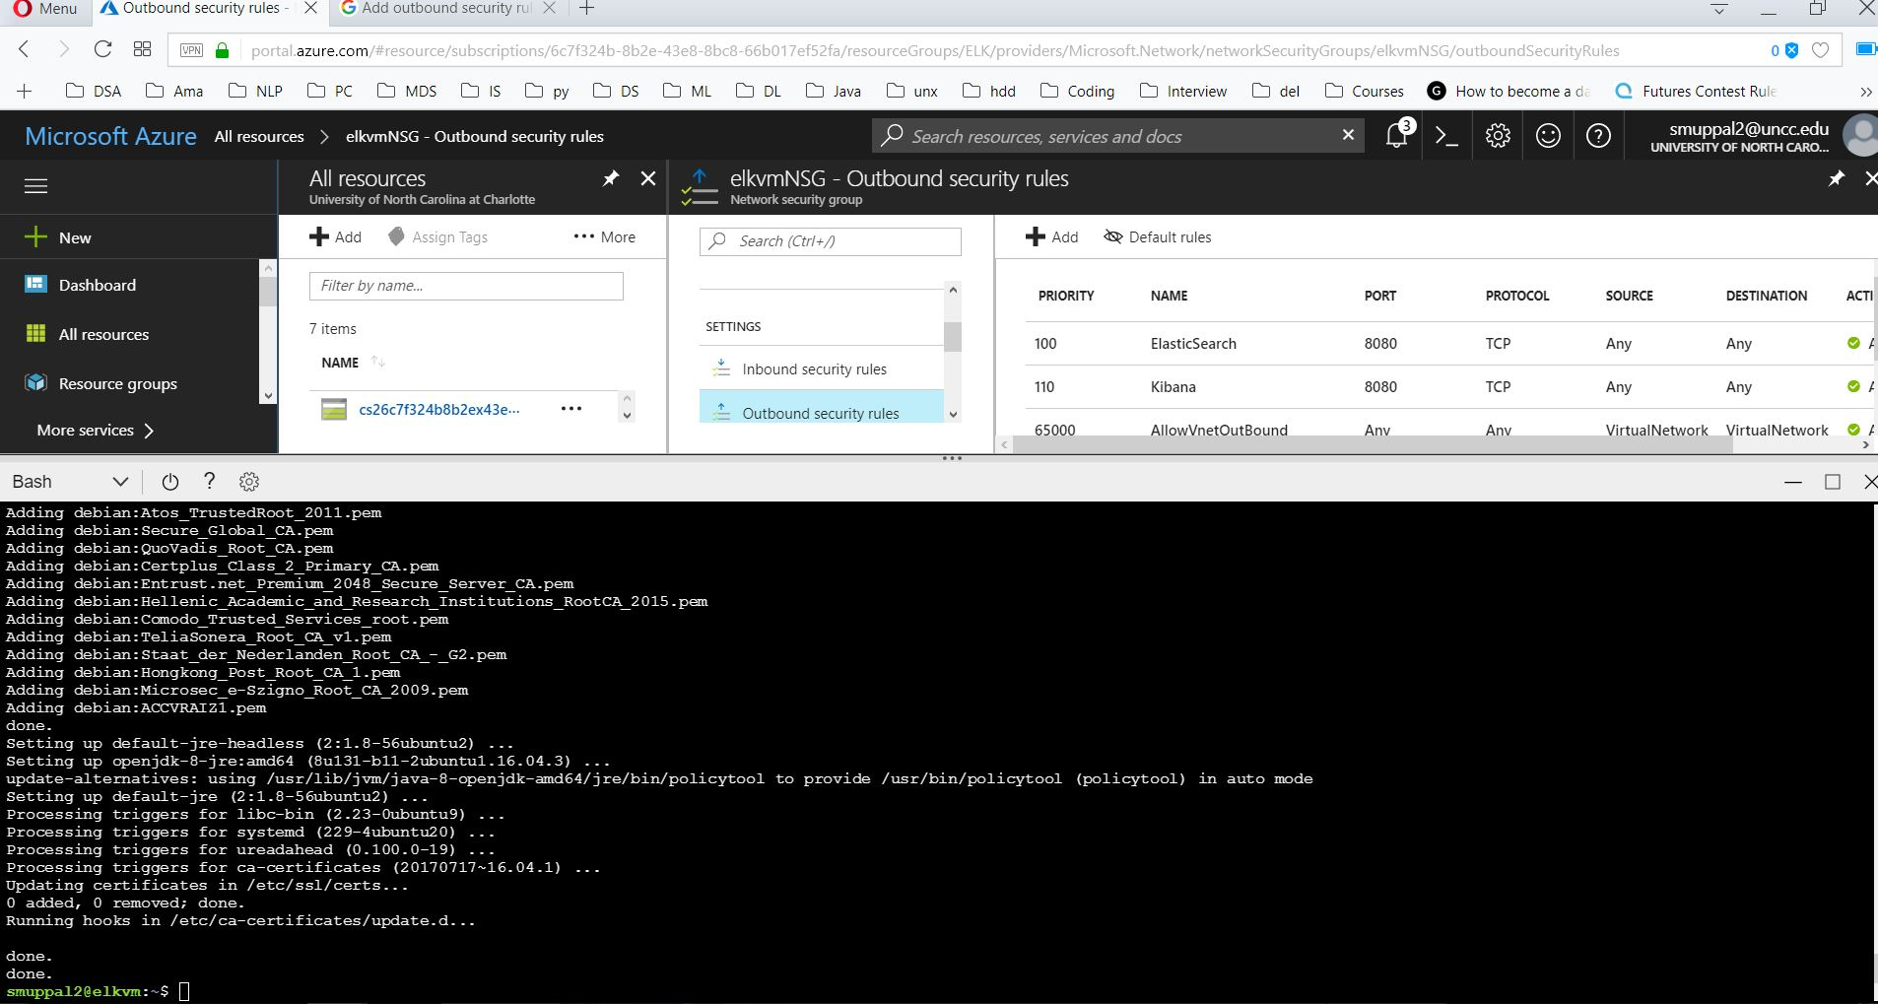
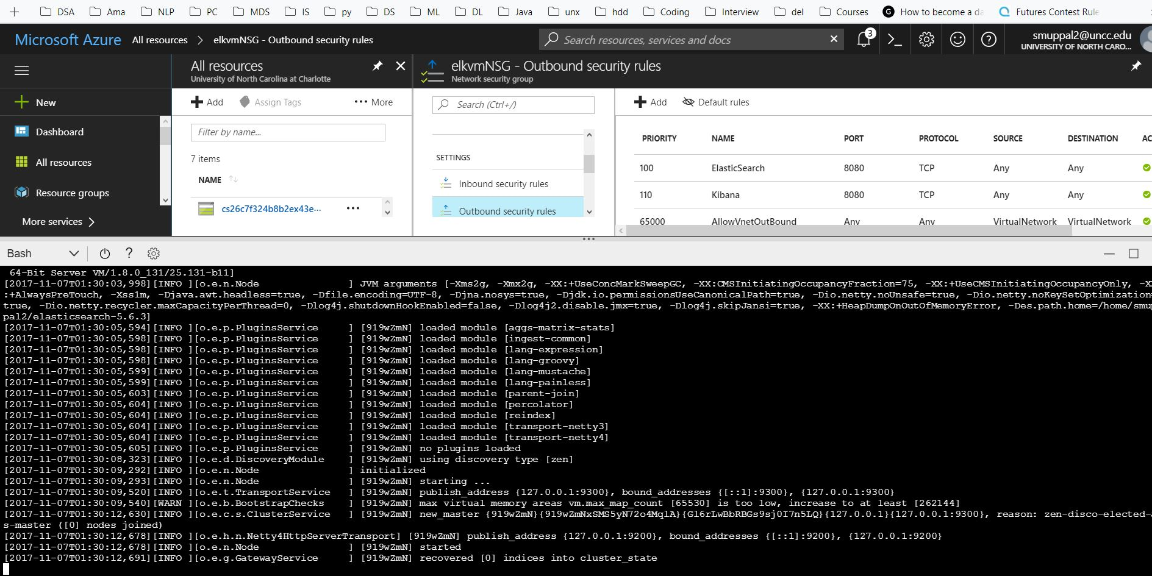
Installation of Solr in Azure

Slide 41
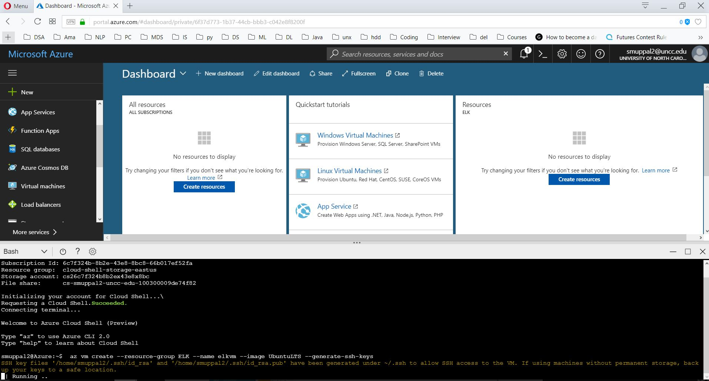
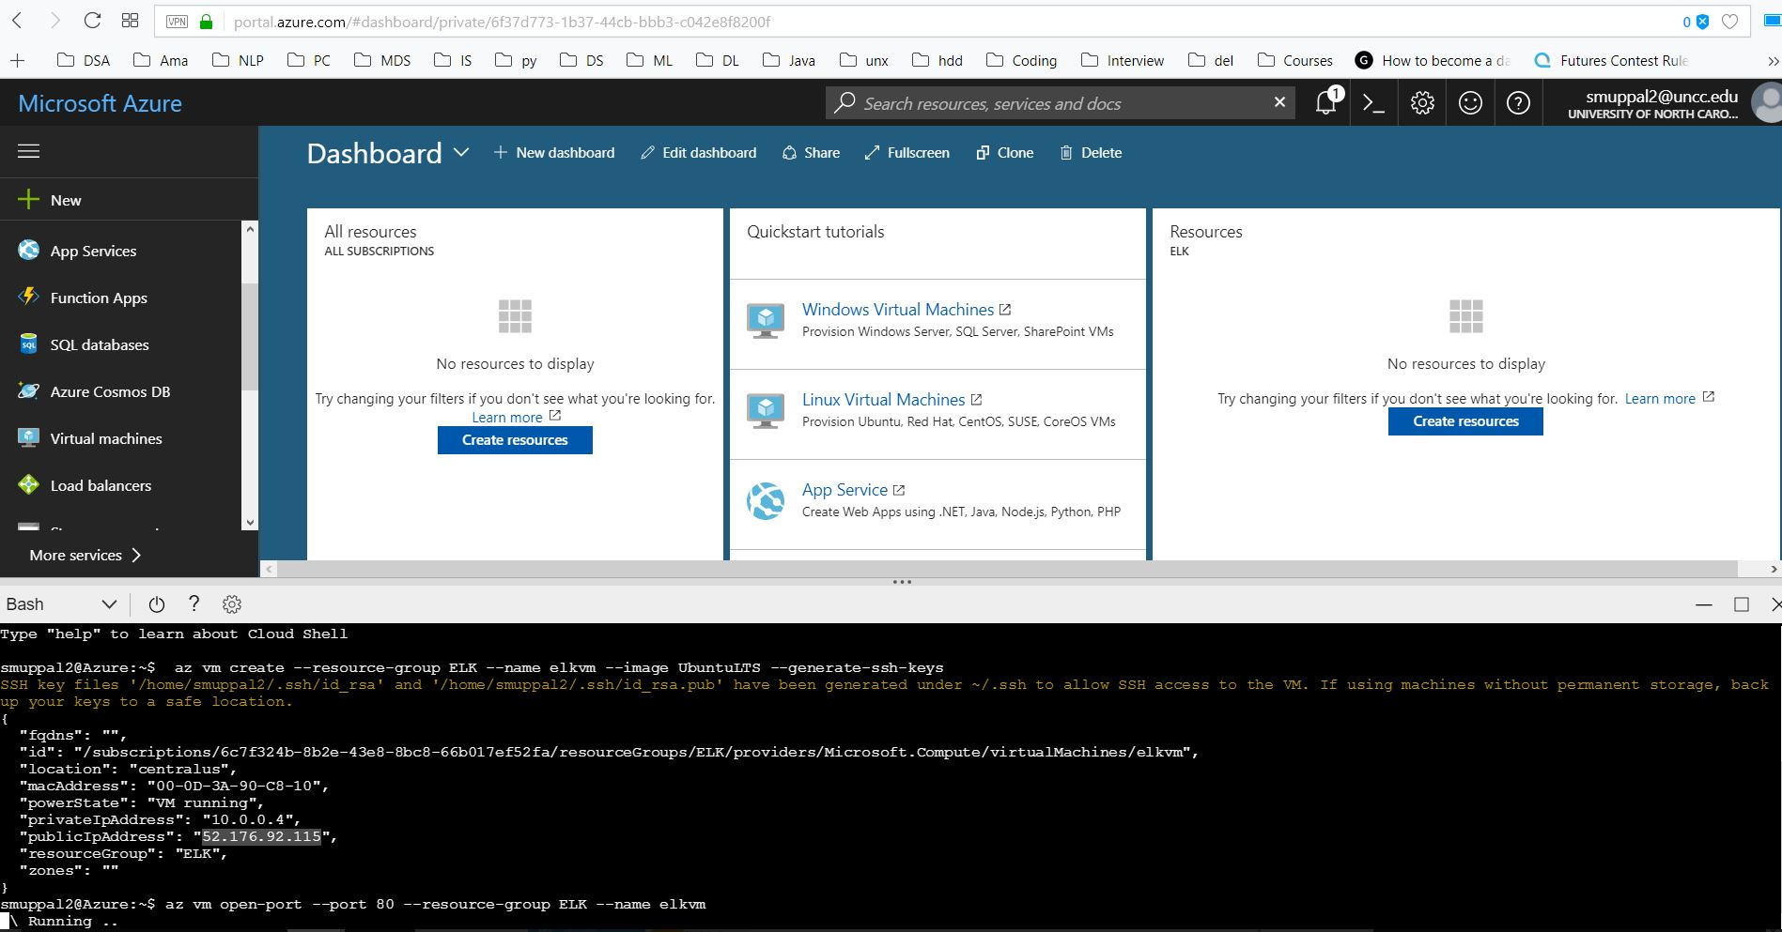
Indexing in Solr
Solr on Azure

Slide 42
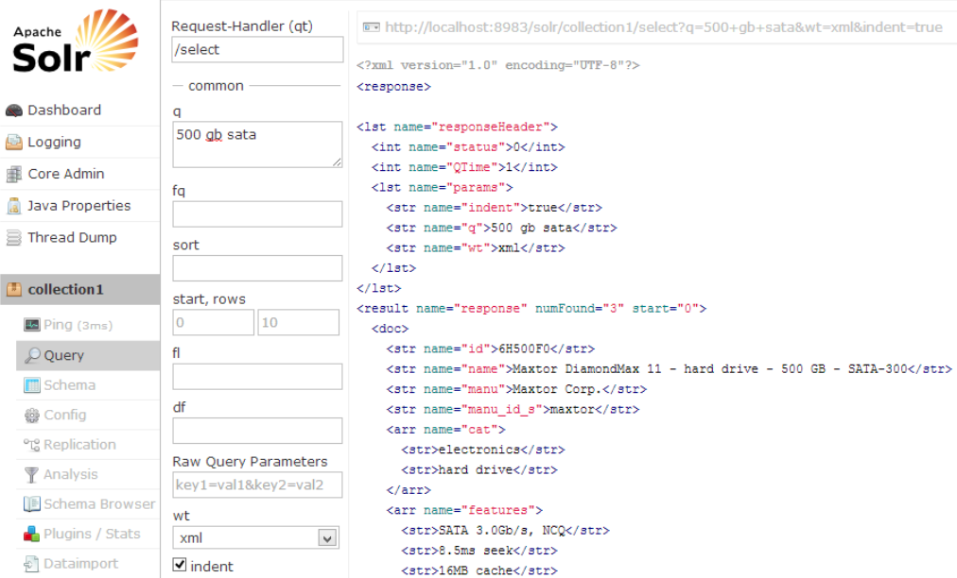
Indexed Wikipedia data in Solr

Slide 43
Feature | Solr/SolrCloud | Elasticsearch
Shard Placement | Static in nature, requires manual work to migrate shards | Dynamic, shards can be moved on demand depending on the cluster state
Analytics Engine | Facets and powerful streaming aggregations | Sophisticated and highly flexible aggregations
Search Speed | Best for static data, because of caches and uninverted reader | Very good for rapidly changing data, because of per segment caches
Machine Learning | Built-in – on top of streaming aggregations focused on logistic regression and learning to rank contrib module | Commercial feature, focused on anomalies and outliers and time-series data
DevOps Friendliness | Not fully there yet, but coming | Very good APIs

Slide 44
CREDITS
https://logz.io/blog/elk-stack-google-cloud/
https://dzone.com/articles/how-to-install-the-elk-stack-on-google-cloud-platf-1
https://www.elastic.co/blog/loading-wikipedia
https://dumps.wikimedia.org/other/cirrussearch/current/
https://www.digitalocean.com/community/tutorials/how-to-use-kibana-dashboards-and-visualIzations
https://github.com/elastic/examples/tree/master/Exploring%20Public%20Datasets/earthquakes
https://stackoverflow.com/questions/3846793/running-solr-on-azure

